Slide 1
Identifying Synthetic Content
MASTER SLIDE DECK
For presentation
English
Spanish with details
This master slide deck is NOT used for presentation.
Notes:
References:
1. Media Lab at MIT on Detecting Fakes - https://www.media.mit.edu/projects/detect-fakes/overview/
2. Detect Fakes with Kellogg's online tool - https://detectfakes.kellogg.northwestern.edu/
3. CISA Contextualizing Deepfake Threats to Organizations - https://media.defense.gov/2023/Sep/12/2003298925/-1/-1/0/CSI-DEEPFAKE-THREATS.PDF
4. DARPA: Deepfake Defense Tech Ready for Commercialization, Transition - https://www.darpa.mil/news-events/2024-03-14#:~:text=Through%20the%20Semantic%20Forensics%20
5. Scribbr AI Detector - https://www.scribbr.com/ai-detector/
6. Real Bird Image Wins AI Contest - https://www.scientificamerican.com/article/how-this-real-image-won-an-ai-photo-competition/ (Image3-Real-Bird.webp)
7. Facebook Post with AI-Generated Image of Aligators - https://www.facebook.com/story.php?story_fbid=10105216423848582&id=199109935&mibextid=NoJtEM&rdid=3RMz451RwYXWUi4R (Image1-AI-Aligators.jpeg)
8. Reddit Post Believe it or not this image is AI - https://www.reddit.com/r/ChatGPT/comments/1c8u924/believe_it_or_not_this_image_is_ai/ (Image2-AI-Car.webp)
9. Journalist's Car - https://cpj.org/2023/11/photos-israel-hamas-war-takes-unprecedented-toll-on-journalists/ (Image4-Real-Car.jpg)
10. Image of Man Hunting - https://www.reddit.com/r/aiArt/comments/1dkn336/most_realistic_image_ive_prompted/ (Image5-Real-Hunting_Bear.webp)
11. How to Spot a Deepfake - https://time.com/6266606/how-to-spot-deepfake-pope/ (Image6-AI-Pope.png)
12. X Post about Mob attacking Journalist - https://x.com/AbujomaaGaza/status/1798366219546071081 (Image7-Real-Mob_Journalist.jpg)
13. Man Carrying Kids out of Gaza Fact Check - https://factcheck.afp.com/doc.afp.com.33ZJ8WU (Image8-AI-Man_Carrying_Kids.jpg) (Image8-AI-Man_Carrying_Kids.jpeg, Image9-AI-FACTHCHECK-Man_Carrying_Kids.jpeg)

Slide 2
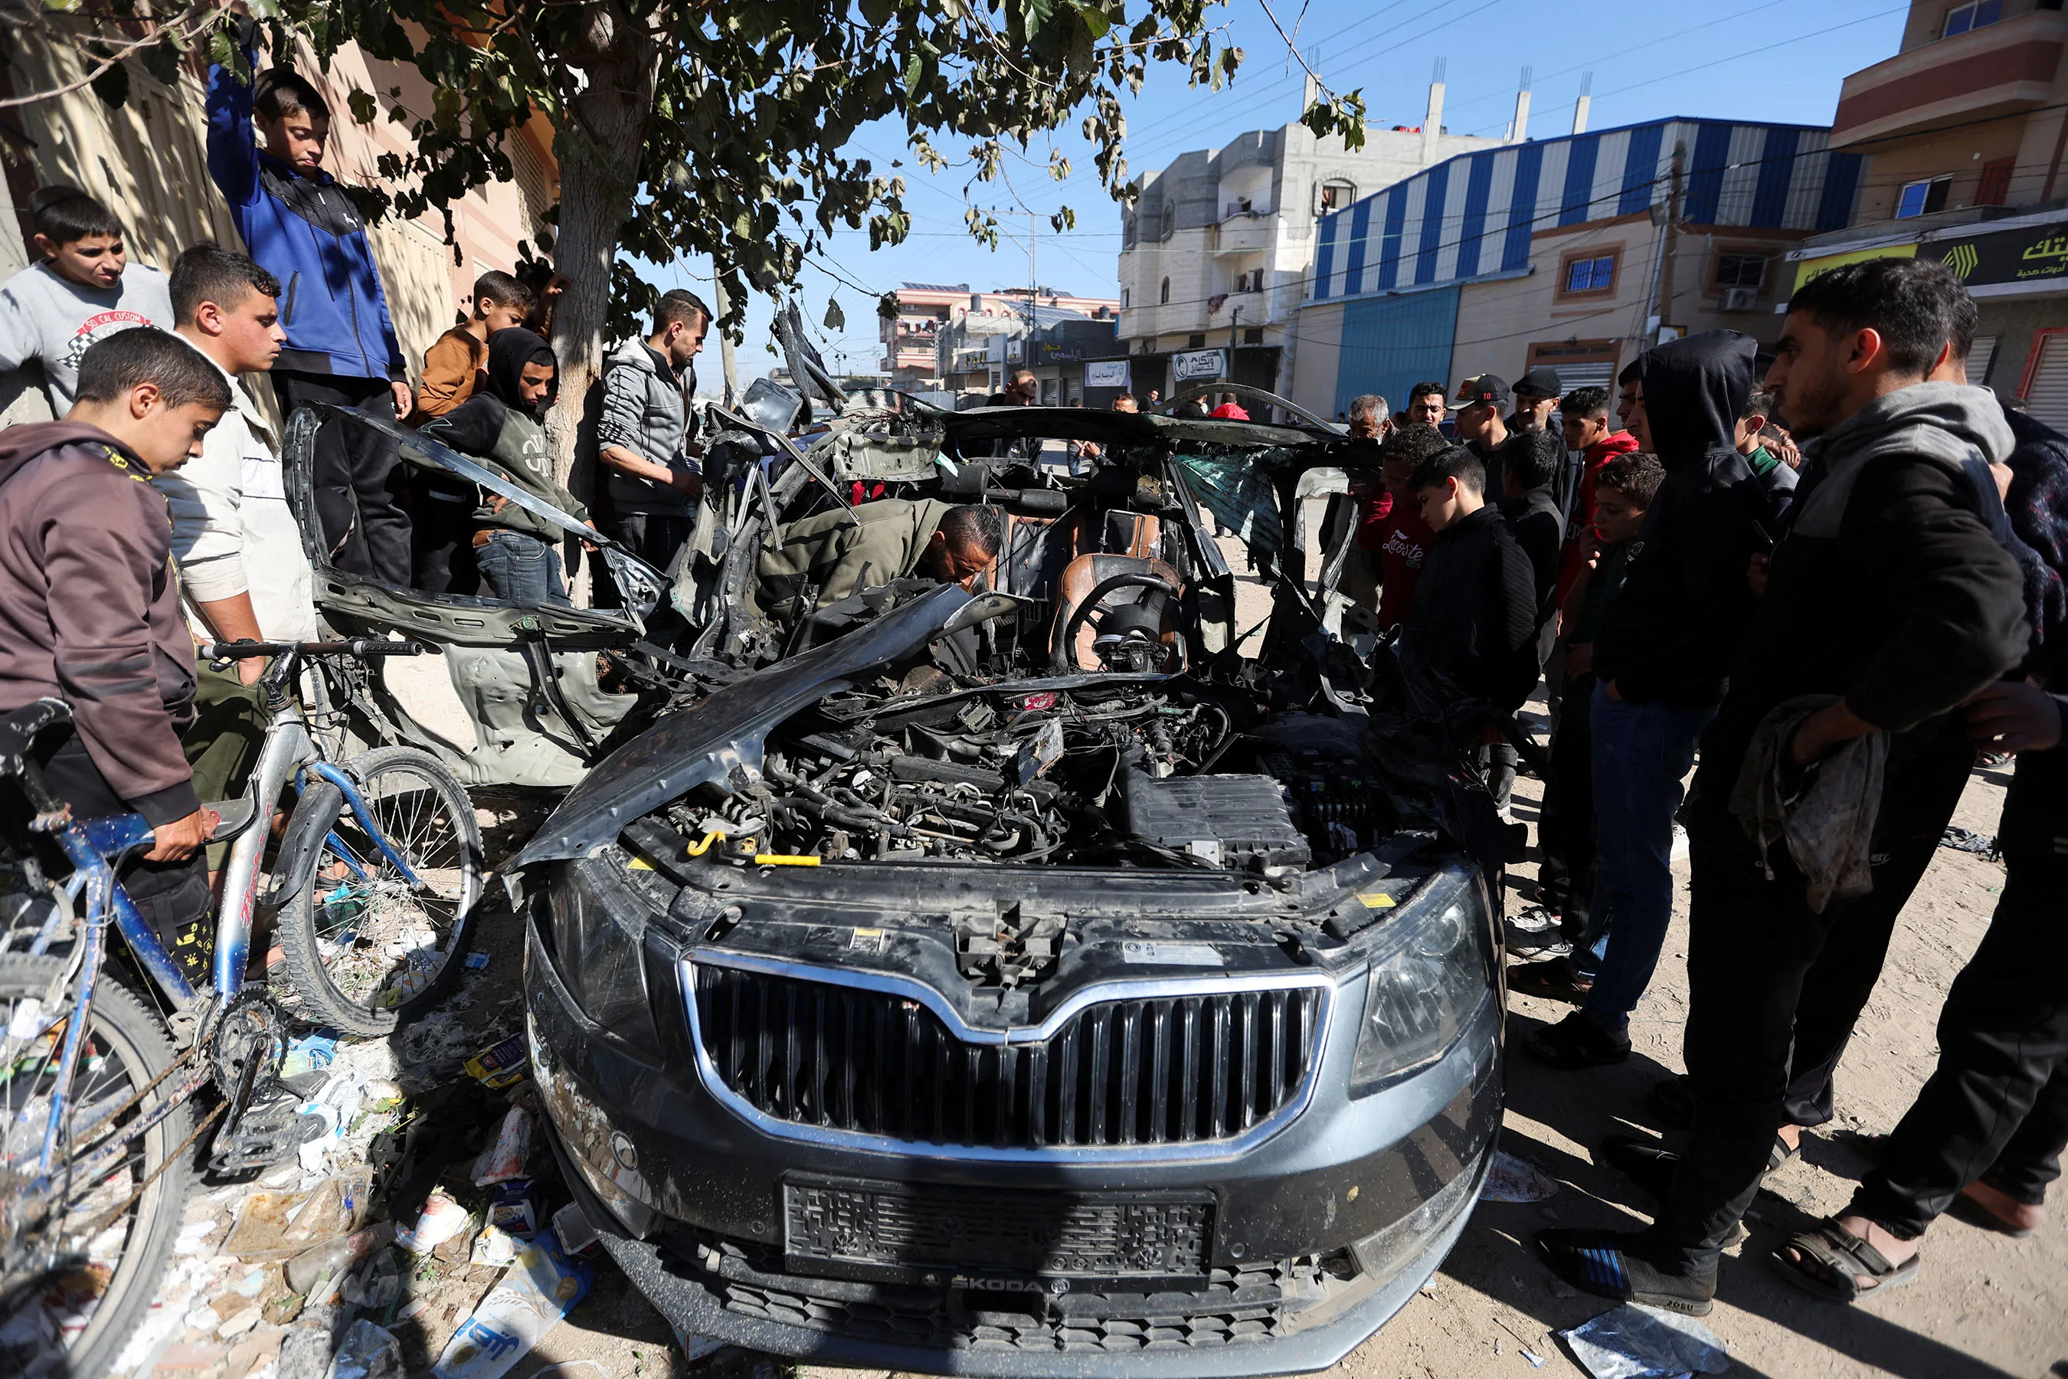
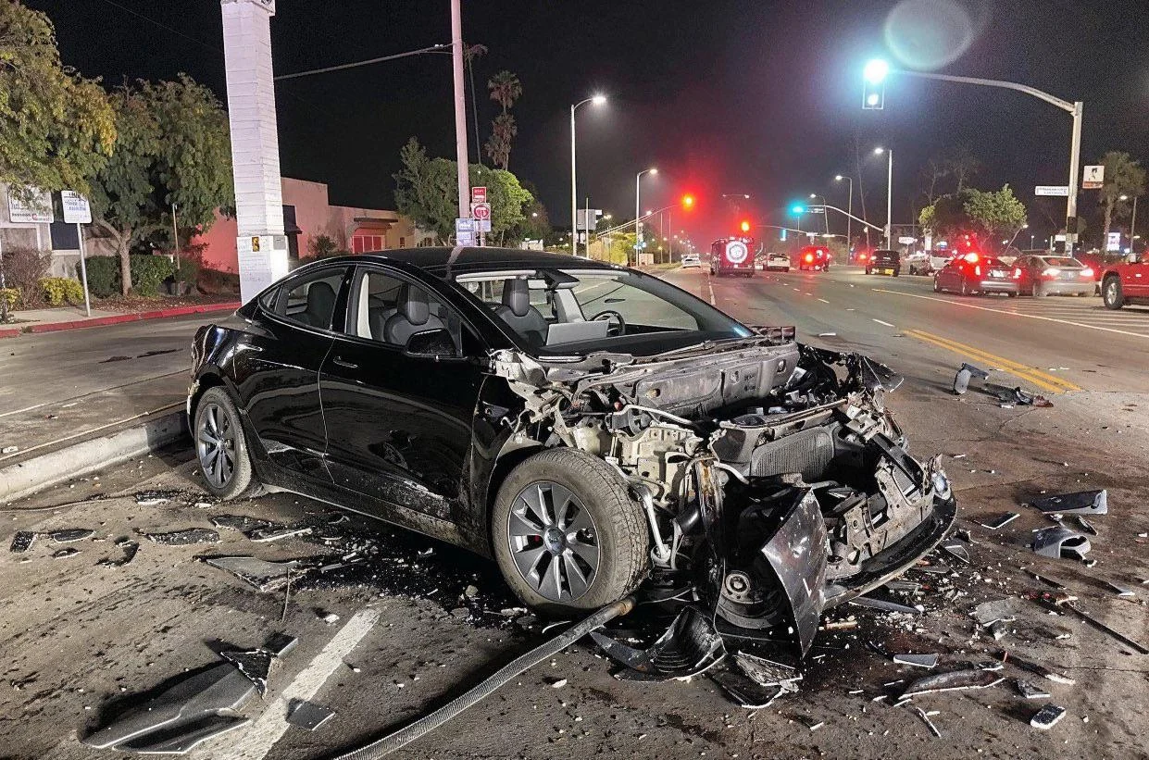
Which is Real?

Slide 3
¿Cual es real?

Slide 4


Which is Real?

Slide 5
¿Cual es real?

Slide 7
Identifying Synthetic Content
Notes:
Start by creating a slide master that is in English. As needed duplicate and translate slides into target language. Color English slides in Yellow and target language slides in white. The example below uses Spanish as a theoretical target language.

Slide 8
Identificación de Contenido Sintético
Notes:
Start by creating a slide master that is in English. As needed duplicate and translate slides into target language. Color English slides in Yellow and target language slides in white. The example below uses Spanish as a theoretical target language.

Slide 9
Lesson Objectives
Identify AI-generated content effectively using specific detection techniques for images, text, and audio.
References:
Media Lab at MIT on Detecting Fakes
Detect Fakes with Kellogg's online tool
CISA Contextualizing Deepfake Threats to Organizations
DARPA: Deepfake Defense Tech Ready for Commercialization, Transition

Slide 10
Objetivos de la Lección
Identifique contenido generado por IA de manera efectiva utilizando técnicas de detección específicas para imágenes, texto y video.
Referencias:
Media Lab at MIT on Detecting Fakes
Detect Fakes with Kellogg's online tool
CISA Contextualizing Deepfake Threats to Organizations
DARPA: Deepfake Defense Tech Ready for Commercialization, Transition

Slide 11
Synthetic Check: Human Image
Context of the scene
Hands and limbs of people
Face and facial features
Clothes and items

Slide 12
Proceso de detección sintética: Imagen Humana
Contexto de la escena
Manos y extremidades de personas
Rostro y rasgos faciales.
Ropa y artículos

Slide 13
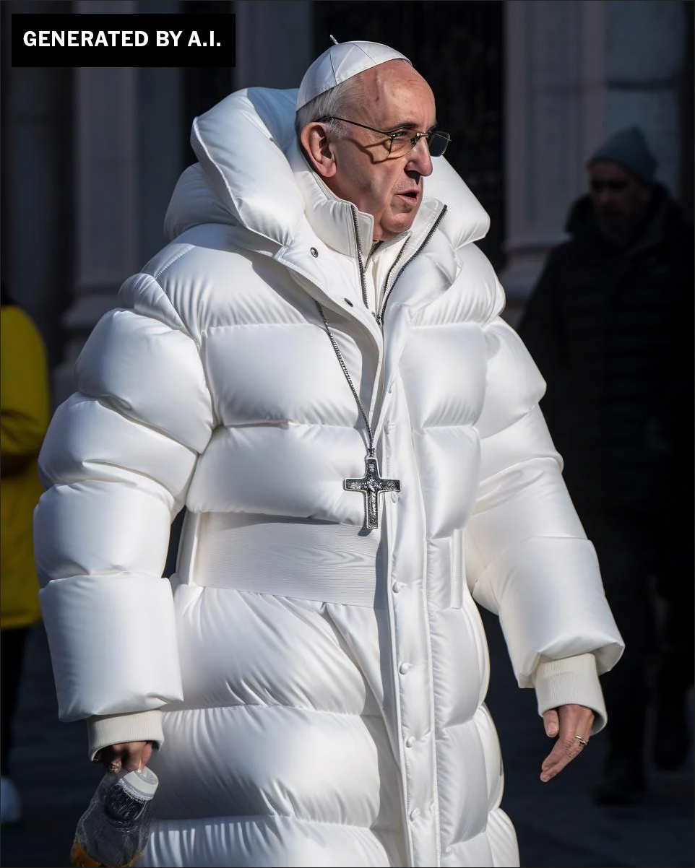
Human Images

Slide 14
Imagen Humana
¿ Qué Percibes?

Slide 15
Human Images: Context
Logic and Context of the Scene

Slide 16
Imagen Humana: Context
Contexto de la escena

Slide 17
Human Images: Hands and Limbs
Pay Attention to the Hands and Fingers

Slide 18
Imagen Humana : Hands and Limbs
Manos y extremidades de personas

Slide 19
Human Images: Face
Pay Attention to the Face
Pay attention to the cheeks and forehead
Pay attention to the eyes and eyebrows
Pay attention to the glasses
Pay attention to facial hair
Pay attention to facial moles

Slide 20
Human Images: Face
Presta atención a la cara
Presta atención a las mejillas y la frente.
Presta atención a los ojos y las cejas.
Presta atención a las gafas.
Presta atención al vello facial
Presta atención a los lunares faciales.

Slide 21
Human Images: Clothing
Pay attention to the clothes
Warped Items
Missing and Extra items
Perspective and Geometry
Repetition in Detail
Material Texture

Slide 22
Human Images: Clothing
Presta atención a la ropa.
Artículos deformados
Artículos faltantes y adicionales
Perspectiva y Geometría
Repetición en detalle
Textura del material

Slide 23
Human Image Check
Context of the scene
Hands and limbs of people
Face and facial features
Clothes and items

Slide 24
Proceso de detección sintética: Imagen Humana
Context of the scene
Hands and limbs of people
Face and facial features
Clothes and items

Slide 25
Human Image Check
Context of the scene
Hands and limbs of people
Face and facial features
Clothes and items

Slide 26
Proceso de detección sintética: Imagen Humana
Contexto de la escena
Manos y extremidades de personas
Rostro y rasgos faciales.
Ropa y artículos

Slide 27

Human Images: Check On Learning
What do you notice?
Notes:
The scene, consider the bear sneaking up on him (bears can be noisy) See the extra drawstring on the hoody See the texture of the Visibility vest which is very different than outdoor gear

Slide 28
Proceso de detección sintética: Imagen Humana: Practica
¿ Qué Percibes?
Notes:
The scene, consider the bear sneaking up on him (bears can be noisy) See the extra drawstring on the hoody See the texture of the Visibility vest which is very different than outdoor gear

Slide 29

Human Images: Check On Learning
What do you notice?
Notes:
Notice the hands
Notice how long the boys shoulder would need to be
Notice the toes
Notice the dark figure in the background

Slide 30
Proceso de detección sintética: Imagen Humana: Practica
¿Qué Percibes?
Notes:
Notice the hands
Notice how long the boys shoulder would need to be
Notice the toes
Notice the dark figure in the background

Slide 31
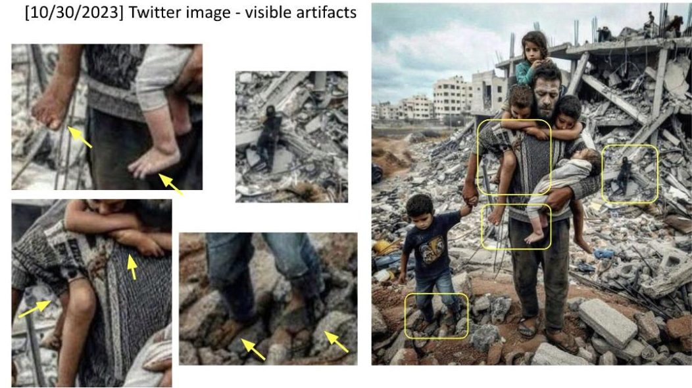

Slide 32
Structure Image Check
Context of the scene
Structural Consistency
Material Texture
Lighting and Shadows
Perspective and Geometry
Repetition in Detail
Missing Elements
Nonsensical Object Placement
Disrupted Continuity
Anomalies in Common Patterns

Slide 33
Proceso de detección sintética: Estructuras
Contexto de la escena
Consistencia estructural
Textura del material
Iluminación y sombras
Perspectiva y Geometría
Repetición en detalle
Elementos faltantes
Colocación de objetos sin sentido
Continuidad interrumpida
Anomalías en patrones comunes

Slide 34
Structure Image
What do you notice?
Notes:
the lanes are nonsensical
The green light on top
The Light posts seem odd
The signs and language seem nonsensical
Some of the cars have no tires
This is supposed to be a tesla but the wheels are off
The windshield seems to disappear in some areas.

Slide 35
Imagen de una escena
¿ Qué Percibes?
Notes:
the lanes are nonsensical
The green light on top
The Light posts seem odd
The signs and language seem nonsensical
Some of the cars have no tires
This is supposed to be a tesla but the wheels are off
The windshield seems to disappear in some areas.

Slide 36
Structure Image
Structural Consistency
Perspective and Geometry
Repetition in Detail
Nonsensical Object Placement
Anomalies in Common Patterns

Slide 37
Imagen de una escena
Consistencia estructural
Perspectiva y Geometría
Repetición en detalle
Colocación de objetos sin sentido
Anomalías en patrones communes

Slide 38
Structure Image
Structural Consistency
Perspective and Geometry
Repetition in Detail
Nonsensical Object Placement
Anomalies in Common Patterns

Slide 39
Imagen de una escena
Consistencia estructural
Perspectiva y Geometría
Repetición en detalle
Colocación de objetos sin sentido
Anomalías en patrones communes

Slide 40
Structure Image
Structural Consistency

Slide 41
Imagen de una escena
Consistencia estructural

Slide 42
Structure Image: Check On Learning
Context of the scene
Structural Consistency
Material Texture
Lighting and Shadows
Perspective and Geometry
Repetition in Detail
Missing Elements
Nonsensical Object Placement
Disrupted Continuity
Anomalies in Common Patterns

Slide 43
Proceso de detección sintética: Estructuras
Context of the scene
Structural Consistency
Material Texture
Lighting and Shadows
Perspective and Geometry
Repetition in Detail
Missing Elements
Nonsensical Object Placement
Disrupted Continuity
Anomalies in Common Patterns

Slide 44
Structure Image Check
Context of the scene
Structural Consistency
Material Texture
Lighting and Shadows
Perspective and Geometry
Repetition in Detail
Missing Elements
Nonsensical Object Placement
Disrupted Continuity
Anomalies in Common Patterns

Slide 45
Proceso de detección sintética: Estructuras
Contexto de la escena
Consistencia estructural
Textura del material
Iluminación y sombras
Perspectiva y Geometría
Repetición en detalle
Elementos faltantes
Colocación de objetos sin sentido
Continuidad interrumpida
Anomalías en patrones comunes

Slide 46
Synthetic Video Check: Practical Exercise
Context of the scene
Structural Consistency
Material Texture
Continue with Techniques…
Search online for possible deepfake videos that have been in the news
Analyze the video
Determine your own TTP for detecting synthetic videos
Present TTPs

Slide 47
Comprobación de vídeo sintético: ejercicio práctico
Contexto de la escena
Consistencia estructural
Textura del material
Continuar con Técnicas…
Busque videos deepfake que hayan aparecido en las noticias
Analiza el vídeo
Determina tus propias técnicas para detectar vídeos sintéticos.
Presentar técnicas de detección de vídeo sintético.

Slide 48
References
1. Media Lab at MIT on Detecting Fakes - https://www.media.mit.edu/projects/detect-fakes/overview/
2. Detect Fakes with Kellogg's online tool - https://detectfakes.kellogg.northwestern.edu/
3. CISA Contextualizing Deepfake Threats to Organizations - https://media.defense.gov/2023/Sep/12/2003298925/-1/-1/0/CSI-DEEPFAKE-THREATS.PDF
4. DARPA: Deepfake Defense Tech Ready for Commercialization, Transition - https://www.darpa.mil/news-events/2024-03-14#:~:text=Through%20the%20Semantic%20Forensics%20

Slide 49
Referencias
1. Media Lab at MIT on Detecting Fakes - https://www.media.mit.edu/projects/detect-fakes/overview/
2. Detect Fakes with Kellogg's online tool - https://detectfakes.kellogg.northwestern.edu/
3. CISA Contextualizing Deepfake Threats to Organizations - https://media.defense.gov/2023/Sep/12/2003298925/-1/-1/0/CSI-DEEPFAKE-THREATS.PDF
4. DARPA: Deepfake Defense Tech Ready for Commercialization, Transition - https://www.darpa.mil/news-events/2024-03-14#:~:text=Through%20the%20Semantic%20Forensics%20

Slide 50

Why Does It Matter To You?

Slide 51
¿Por Qué Te Importa?

Slide 52

TAKE A BREAK
Return By: XX:XX

Slide 53
TOMAR UN DESCANSO
Volver por: XX:XX

